Slide 1

Analyzing customer feedback The Starbucks Survey Insights
FINAL PROJECT
TEAM 14
AKHIL AREKATIKA
PRITHAM MAHAJAN
NITHISH BILASUNUR MANJUNATHA REDDY

Slide 2
DATASET USED StaRBUCKS customer SATISFACTORY SURVEY
Nearest Starbucks outlet
Membership status
Frequency of Purchase
Wifi Quality at outlet
Customer’s Occupation
Likelihood of choosing Starbucks for meetings/hangouts
Ambience Rating
Customer’s Age
Customer’s Gender
Notes:
Starbucks store in Malaysia questioned its customers to learn more about their buying behavior

Slide 3
RESEARCH QUESTIONS
How are the Preferences between students and employed individuals ?
How does the distance to the Starbucks outlet affect the choice of dining ?
Predicting Starbucks Revisiting based on Price,Wifi,Rating and Service
How Service at starbucks affects the likelihood of choosing starbucks for meetings/hangouts?

Slide 4
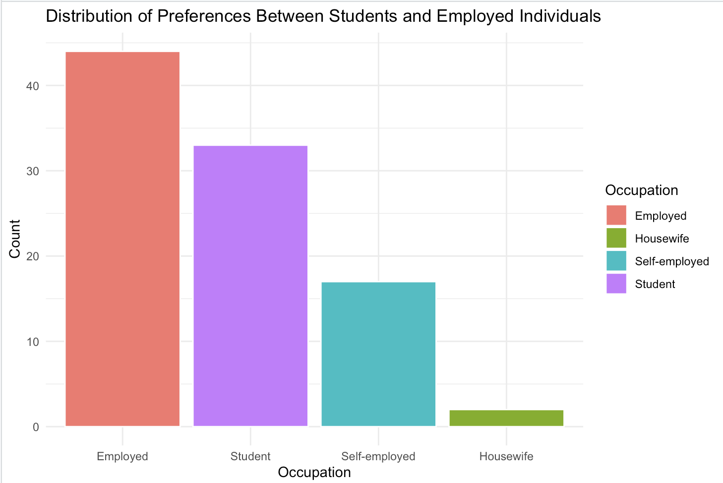
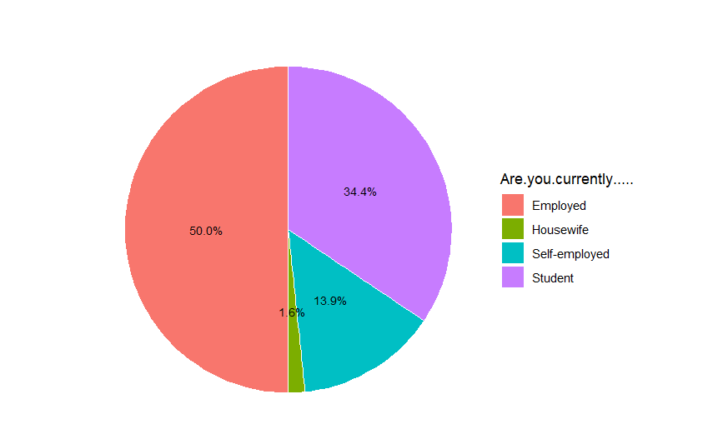
Preferences between students and employed
Employee’s choose Starbucks rather than Students
Pie Chart is for comparison

Slide 5
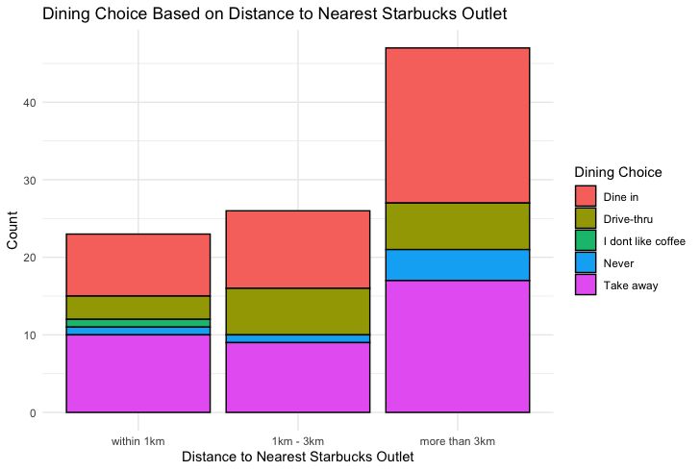
DINING CHOICE BASED ON DISTANCE
Stacked Bar Plot
Dining Choice
>3 Km People Opt Dine In
Notes:
This stacked bar plot, represents dining choice based on the nearest outlet.
So within 1km radius, the take aways are slightly higher in percentage than the dine in, whereas in 1-3km radius,
most of the customers prefer dine in.
However, when it comes to 3+km radius, it is seen that both take away and dine in are approximately same, neverthless drive through has consistent proportion throughout various distances

Slide 6
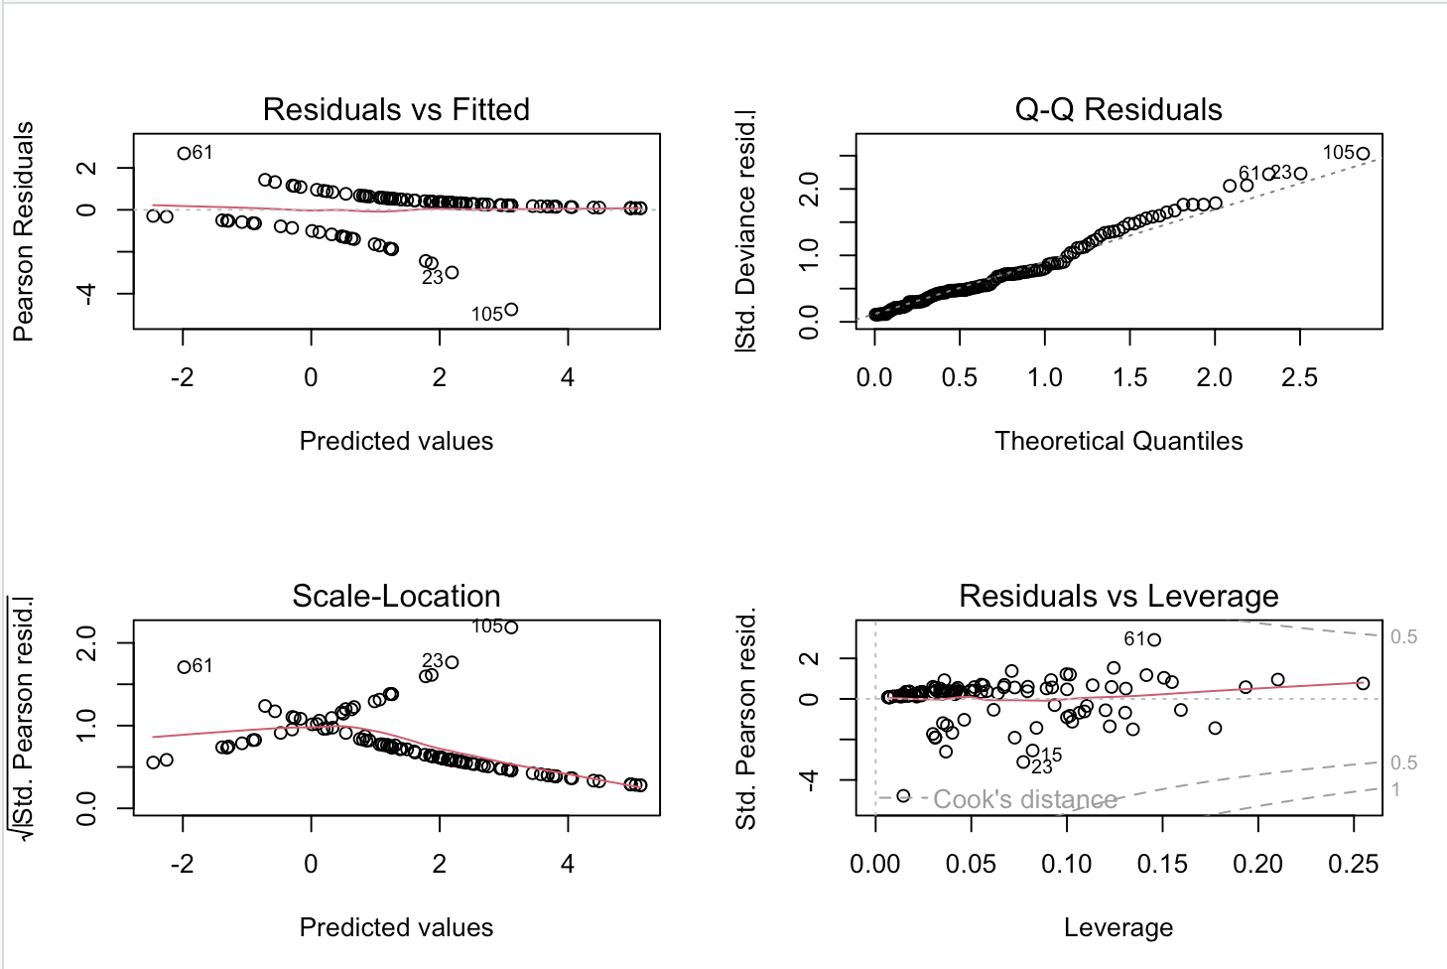

Starbucks Revisit Predictors: Based on Price, Ambiance, Service, Ratings
Logistic Regression
Predictor Variables: Ambience, Wifi, Service,Rating
Outcome Variable: Loyalty
Notes:
The logistic regression model is predicting Customer loyalty based on several predictor variables including , ‘pricerate’, ‘promotion’, ‘rate of ambiance’, ‘Wifi’, and ‘rate of service’.
The coefficients of the model indicate the change in the log odds of the outcome for a one unit increase in the predictor variable.
For example, for every unit increase in ‘pricerate’, the log odds of ‘Y’ that is Loyalty increase by 1.1513311.
The variables ‘Wifi’ and ‘rateservice’ have negative coefficients, indicating that for every unit increase in these predictors, the log odds of ‘y’ that is loyalty decrease.

Slide 7
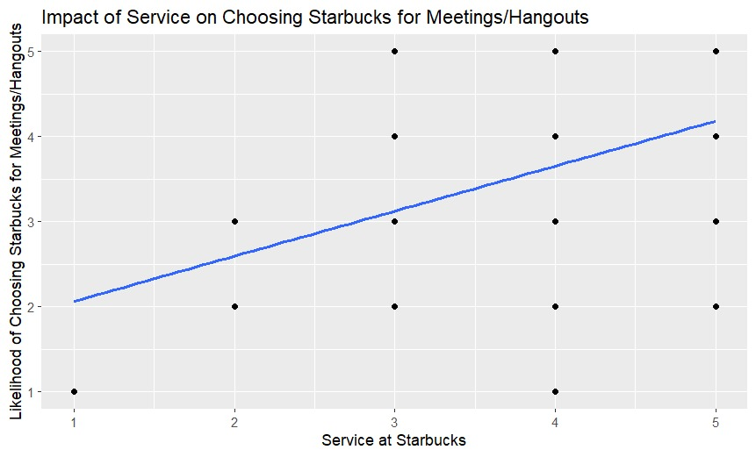
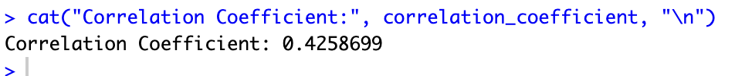
Impact of service on choosing starbucks for meetings/hangouts
Linear Regression
Dependent Variable: Service
Independent Variable: Choosing Starbucks for Meetings
Notes:
I’ll be explaining more about the Relationship B/w Service and Likelihood of Customer's Choosing starbucks for Meetings
We have implemented Linear Regression model on two Variables Service at starbucks and Choosing starbucks for meetings
In this scatter plot the x-axis represents the service at Starbucks, and
the y-axis represents the likelihood of choosing Starbucks for meetings or hangouts.
The blue line showing that there is a gradual increase in choosing Starbucks for meetings as the service improves.
The correlation coefficient of 0.42 indicates a positive relationship between the two variables.
the scatter of points around the line indicates that there are other factors at play as well, being the most important will be service.
Also It shows that as the service at Starbucks increases, the percentage of choosing Starbucks for also increases (moving up along the y-axis).

Slide 8
conclusion
Employee’s preferring Starbucks more
Dine In & Take Aways are higher percentage methods
Customer Revisiting Depends on Ambience,Wifi,Service etc
How Service depends on the Likelihood of choosing starbucks for Meetings/Hangouts
Notes:
Coming to the conclusion, we have seen that most of the customer’s of starbucks are Employees.
The stacked bar plot illustrated dining preferences based on the nearest outlet.
The logistic regression model presented Customer's revisting Starbucks based on Ambience,Rating,Wifi and Service.
At last, The linear regression model was applied to understand how people choose Starbucks for meetings based on the service provided.

Slide 9
THANK YOU
AKHIL AREKATIKA
PRITHAM MAHAJAN
NITHISH BILASUNUR MANJUNATHA REDDY

